Slide 1
FUJIFILM SonoSite Internship
CSS Capstone
student Joel Maxwell
advisor Dr. Kelvin Sung
mentors Eddie Patton, Ray Woods

Slide 2
About Me
Joel Maxwell
Senior
Computer Science / Software Engineering

Slide 3

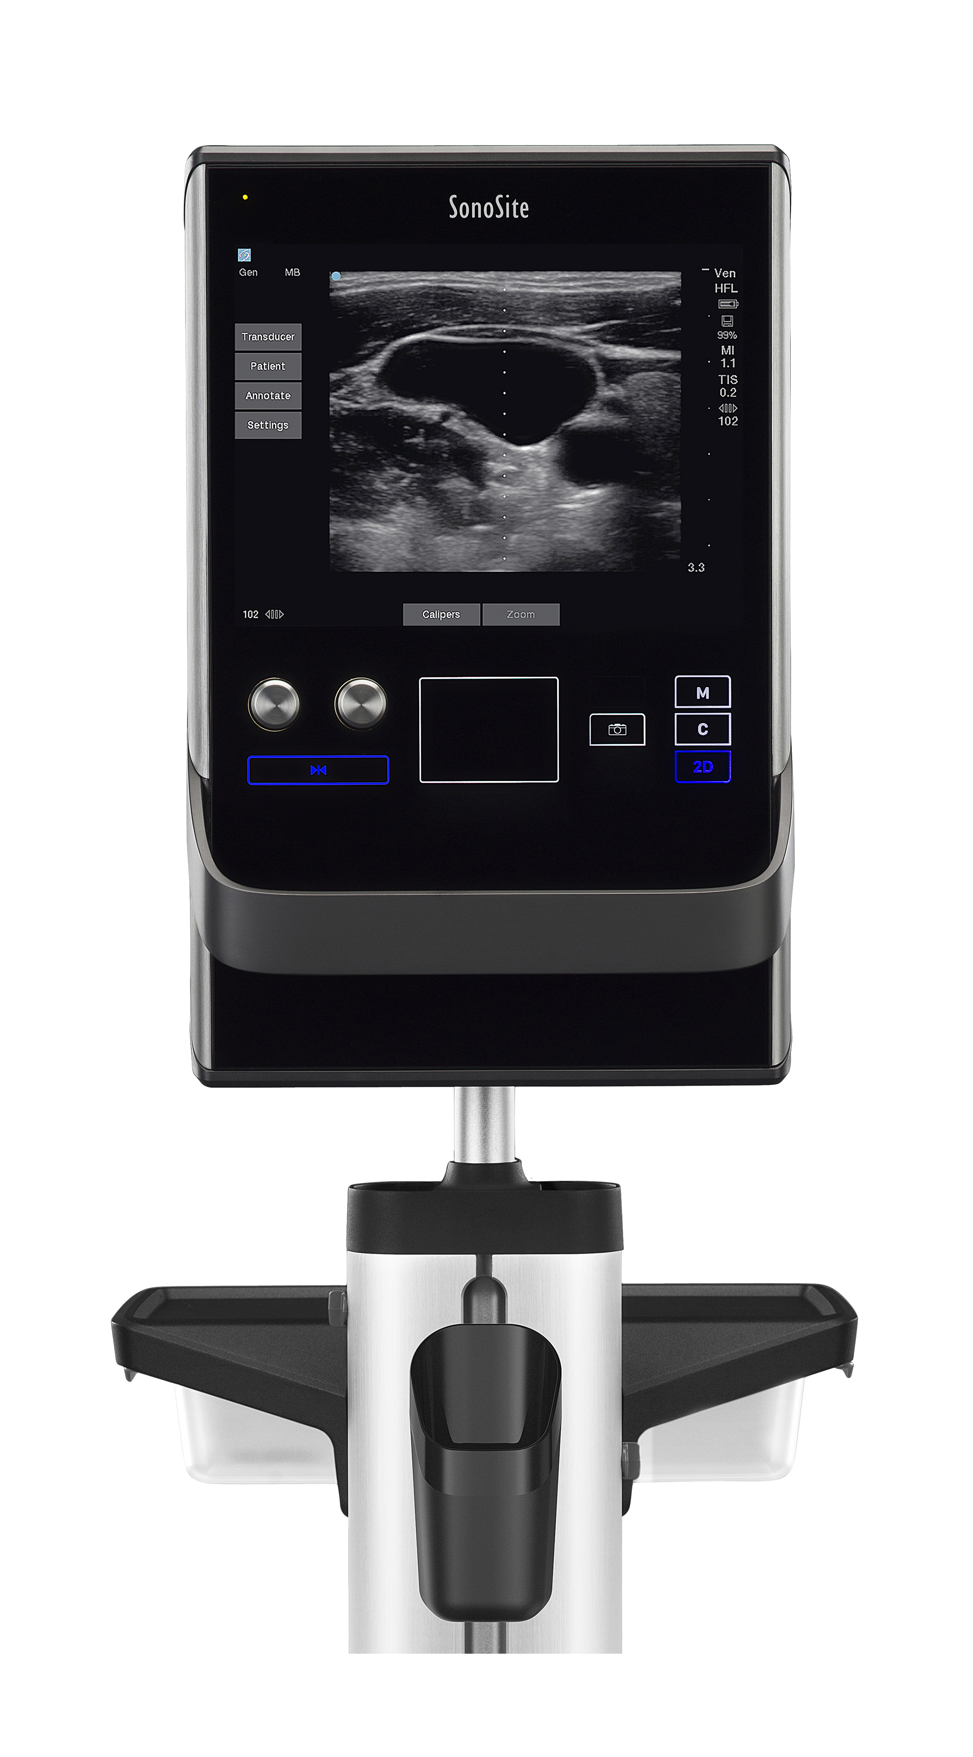

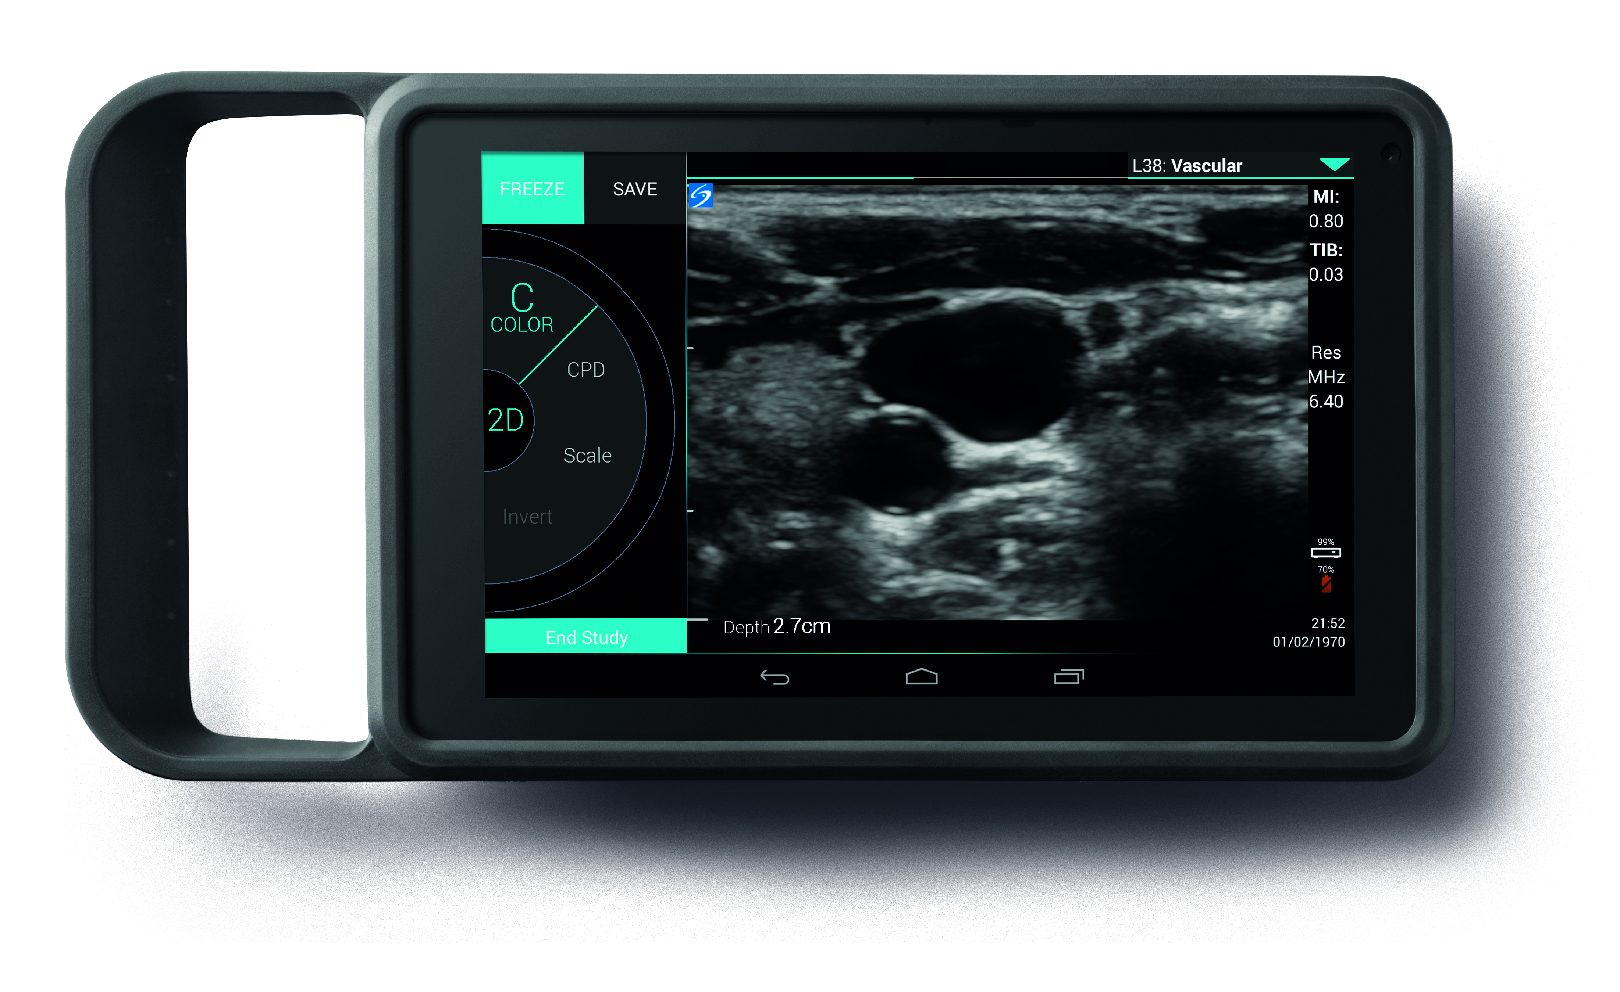
About SonoSite
Located in Bothell
Specializes in creating point-of-care ultrasound systems
I interned with a team developing the software for a product powered by an Android-based operating system
~12 team members
Only intern (with this team)
SonoSite Edge II
SonoSite SII
SonoSite iViz
Images of SonoSite products from www.sonosite.com

Slide 4

My Mission
Integrate the android-based ultrasound system with SonoSite’s proprietary cloud service
Create a tool written in C++ that manufacturing can use to request a certificate and store that certificate in non-volatile product memory
Create an APK (Android app) that uses the above certificate to establish communication with the cloud service

Slide 5
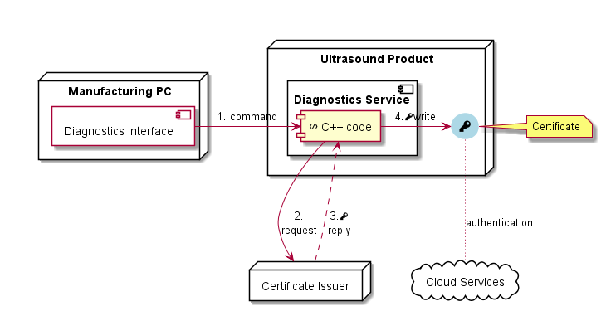
Certificate Management Tool
Module of a suite of diagnostics tools used in manufacturing.
Requests a unique certificate from the certificate server
Saves the certificate non-volatile memory
Certificate will not be removed/overwritten when the system installs a software update
Certificates are used to identify authorized systems accessing the cloud service.
Manufacturing instructs the product to get a certificate.
Product sends a request for a certificate.
Product receives a certificate.
Product stores the certificate.

Slide 6
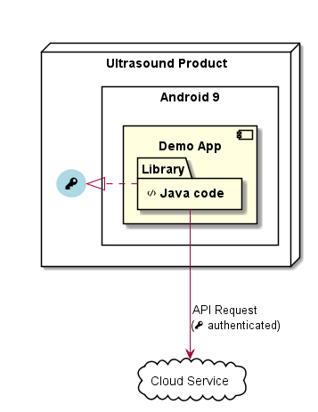
Android App + Java Library
Demonstrates access to the cloud service using the installed certificate
Code for accessing the cloud service is packaged as a code library

Slide 7
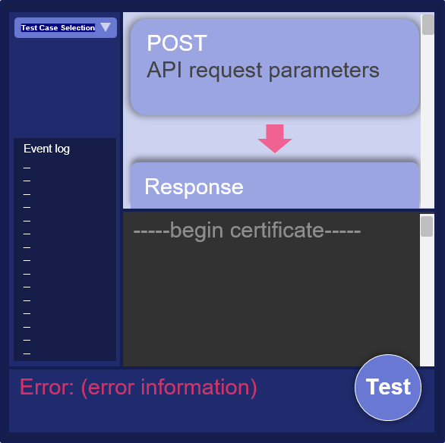
Demo App
Displays device identification information
Displays the installed certificate
Tests cloud service API operations
Logs HTTP requests and responses
Displays error messages
Mockup of the app GUI

Slide 8
Project Results
Added my certificate installer module to the suite of diagnostics tools
Demonstrated that my app can use the certificate to access the cloud service
Provided a Java code library for accessing cloud services using the certificate
Can be added to other apps/services to access the cloud service
Provided written documentation
What I worked on
How to use my tools and app
How to modify and compile my code

Slide 9
Conclusion
Learned about:
Cloud services
REST APIs
Android source code
Work experience
Working independently
Communicating with coworkers
Taking initiative

Slide 10
Questions?

